Slide 1
“Entrepreneurship coaches”
Role description
Entrepreneurship coaches will be a key role at HEIs in detecting entrepreneurial potential in research teams, entrepreneurial skills to be improved in target groups, and providing guidance and counselling to those target groups at the HEI having ideas or innovation that can be potentially turned into business.

Slide 2
SPINTeams at Higher Education Institutions
“ Entrepreneurship coaches”
The role of the Entrepreneurship coach is to support potential future entrepreneurs within their students, to aid them unlock and develop their entrepreneurial capability encouraging them to join the SPINTeams project.
Entrepreneurship and business training
Student
Would-be entrepreneurs
Methodologies → support ecosystem
International cooperation platform

Slide 3
SPINTeams’ ENTREPRENEURIAL ECOSYSTEM at HEIs
“ Entrepreneurship coaches”
Support
Building entrepreneurial support and mentoring ecosystems
International
Cooperation
platform
Students
Would-be entrepreneurs
Start-ups founders
Interactive workshops
Entrepreneurship training course

Slide 4
Coach profile
It is believed that the best working profiles for the coaches could be teachers, PhD students’ mentors, team leaders, or researchers.
In general, the proposed entrepreneurial coaches will have had continuous contact with students, and the associated soft skills, enabling them to form positive working relationships.
Expected involvement
SPINTeams project thanks the coaches for an active and regular involvement in detecting entrepreneurial potential and skills to be improved in target groups, supporting them, developing team building and motivating the networking in the transnational platform.

Slide 5
What is coaching?
Coaching is unlocking a person’s potential to maximise their own performance. It is helping them to learn rather than teaching them. John Whitmore, in Coaching for Performance
A coach must have developed personal qualities such as observation, responsibility, sociability, creativity, cheerfulness, courage, stability, and accuracy.
The main misconception is:
for coaching, I need to succeed in the field where I want to be a coach. Success in any field is welcomed, but the tasks of the coach are to help the client to activate their inner potential, to reveal the hidden capabilities of the person and to help him to achieve their goals.

Slide 6
Coaching
Mentoring
Teaching
Future focused
Ask open questions
Enables self discovery
Dispels false feelings ans beliefs
Can be apply to any situation
Answers direct questions
Provides information sources
Seeks alternate answers
Structured
Often highly structured
Ask directive questions
Provides information
Seek specific answers
Base on past experience
Based on past learning
Essential coaching skills
The Ability to:
Structure and set goals (using SMART targets)
Listen Actively: Repeating, Paraphrasing, Summarizing, Looking & Observing.
Establishing a relationship. Building a rapport, showing empathy & understanding.
Be Curious (avoiding assumptions & preconceptions)
Provide a structure throughout the process commitment and empathy.
Aim is to help

Slide 7
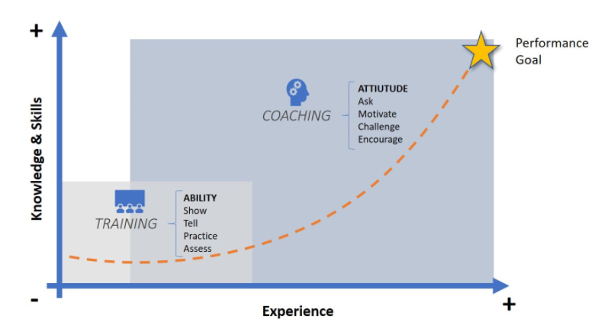
What is an “entrepreneurship coach”?
Coach:
is not a teacher;
does not give homework, does not control, does not order what and how to do;
does not make decisions on behalf of the student.
Coach:
provides the necessary information to help and support the coachee to find a solution on their own;
allows the coachee to make his or her own decision;
encourages the coachee and promotes his / her self-assessment, as well as personal initiative to make decisions and take necessary actions.

Slide 8
Entrepreneurship coach’s pathway
TRAINING
PROJECT INVOLVEMENT
Entrepreneurship competences
Detecting entrepreneurial potential and skills
Supporting would-be entrepreneurs
Team building
Motivating networking
Coaching: Go Into action
Techniques for a Value-based coaching
Would-be entrepreneurs
Entrepreneurship Coaches
Mentors
Business mentors
Investors
International cooperation platform
International
Cooperation
platform

Slide 9
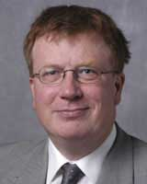
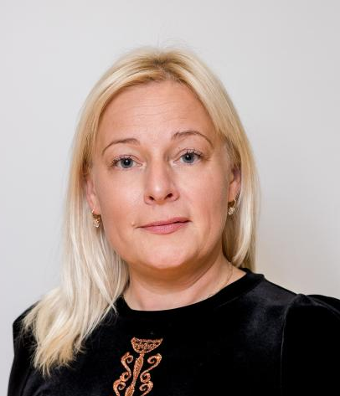
SPINTeams project expects active and regular involvement from the coach detecting entrepreneurial potential and skills to be improved in target groups, supporting them, developing team building and motivating the networking in the transnational platform.
The coach will be trained in their role of detecting, supporting, team building and coaching capacities.
Webinar 1
The “entrepreneurship coach”: Promoting Entrepreneurship
Webinar 2
Coaching:
Go into action!
Webinar 3
Practical Tools & techniques for coaching
9th June
10:00h – 11:30 CET
16th June
10:00h – 11:30h CET
29th June
10:00h – 12:30 CET
Zane Driņķe
is Dean of Faculty of Business Administration of Turiba University (Latvia), teaches quality management and coaching courses.
Elina Valdmane
Head of the competitiveness Department at Latvian Chamber of Commerce and Industry
Frank Hennessey
Head of Business Studies at St. Mary's University College in UK for 35 years. Contributor to the development of the EntreComp
Training and collaboration on the International cooperation platform
Team collaboration
Interactive workshops
Competitions to validation
Support
Adjustable privacy settings
Gain resources and raise capital
Would-be entrepreneurs
Coaches
Mentors
Business mentors
Investors

Slide 10
International Cooperation platform
UOC
UNIBA
TURIBA
GRAZ
CITM
Online platform that allows people to build communities.
Each HEIs will be a HUB (Community) inside the SpinTeams HUB.
Rebelbase’s hubs encourages members to contribute to each other’s success, fosters team bulding and international cooperation.
Hub administrators (SPINTeams partners + Entrepreneurship coaches)
People who organize and activate participants within their community.
Manage ideas and projects as they advance.
Organize events to give your community a chance to pich, get feedback, and earn awards.
Rebels
Would-be entrepreneurs
Mentors
Business mentors
Supporting contributors
Investors
Financing institutions, Public support organizations
Interactive workshops
Team collaboration
Support
Competitions to validation
Gain resources and raise capital

Slide 11
https://www.spinteams.eu/

